Slide 1

Chapter Two
WEB DESIGN AND DEVELOPMENT
FUNDAMENTALS

Slide 2
Contents
Getting started with Web application development
Hypertext Markup Language (HTML)
HTML Tags
HTML Document Structure

Slide 3





Getting started with Web application development
This is introducing you to the practicalities of web application development.
  Installing basic software
    A text editor – Sublime, vs-code, Notepad++ …
    Client software (browser) - Chrome, Firefox, Safari…
    Server-side stack software - WAMP, XAMPP, LAMP…
  What will your website look like?
    plan out the application content and design
  Dealing with files
    set up a sensible file structure

Slide 4


… cont’d
  Client-side scripting
    Client-side or Front-end development manages everything that users visually see first in their browser or application. Front end developers are responsible for the look and feel of a site.
    Front end languages include HTML, CSS, and JavaScript.
  Server-side scripting
    Server-side or Back end development refers to the server side of an application and everything that communicates between the database and the browser.
    Back-end languages such as Java, PHP, Ruby on Rails, Python, and .NET

Slide 5

What is HTML?
HTML stands for Hyper Text Markup Language
HTML is the standard markup language for creating Web pages
HTML describes the structure of a Web page
HTML consists of a series of elements
HTML elements tell the browser how to display the content
HTML elements label pieces of content such as "this is a heading", "this is a paragraph", "this is a link", etc.

Slide 6
Hypertext Markup Language (HTML)
HTML documents are simply text documents with a specific form
Documents comprised of content and markup tags
  Content: actual information being conveyed
  Markup tags: tell the Web browser how to display the page
An HTML file must have an .htm or .html file extension
An HTML file can be created using a simple text editor.

Slide 7
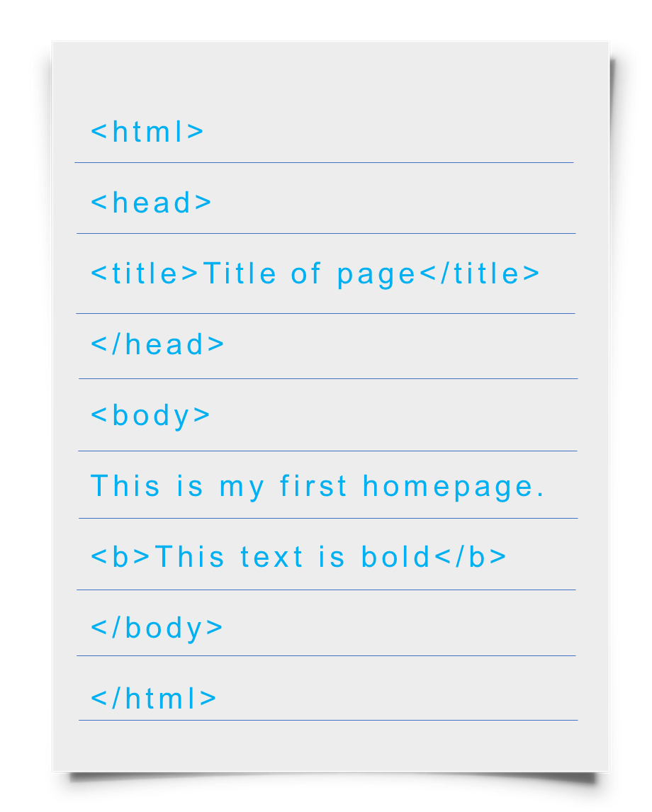
Our First Example
If you are running Windows, start Notepad
Type in the following save as .html extension:
Open this file using a browser, and you will see…

Slide 8
HTML Tags
Tags are one of the most important part in an HTML Document.
HTML uses some predefined tags which tells the browser about content display property, that is how to display a particular given content.
  For Example, to create a paragraph, one must use the paragraph tags(<p> </p>) and to insert an image one must use the img tags(<img />).
There are generally two types of tags in HTML:
  Paired Tags/container : These tags come in pairs. That is they have both opening(< >) and closing(</ >) tags. E.g. <h1> Hello world </h1>
  Empty Tags/standalone: These tags do not require to be closed. E.g. <br/>

Slide 9
… cont’d
HTML tags are keywords (tag names) surrounded by angle brackets:
  <tagname> content </tagname>
The text between the start and end tags is the element content
Not case-sensitive
Follow the latest web standards:
  Use lowercase tags
The end tag is written like the start tag, but with a slash before the tag name
Closing tag
<b> Software Engineering </b>
Opening tag
Content
The start tag is often called the opening tag. The end tag is often called the closing tag.

Slide 10
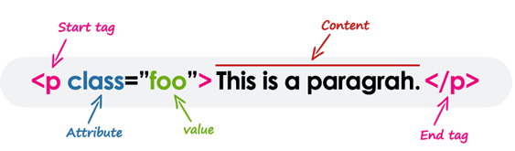
Tag Attributes
Tags can have attributes that provide additional information to an HTML element
Attributes specify properties and behavior
  Attributes always come in name/value pairs like: name=“value”
  Attributes are always specified in the start tag
  Attribute values should always be enclosed in quotes. Double quotes are most common.
  Also case-insensitive: however, lowercase is recommended
  Some elements have obligatory attributes

Slide 11
Some Simple Tags – Example
<!DOCTYPE HTML>
<html>
<head>
<title>Simple Tags Demo</title>
</head>
<body>
  <a href="http://www.amu.edu.et/" title=“amu site">Go to AMU website.</a>
  <br />
  <img src="logo.gif" alt="logo" />
  <br />
  <strong>Bold</strong> and <em>emphasized or italic</em> text.
</body>
</html>

Slide 12
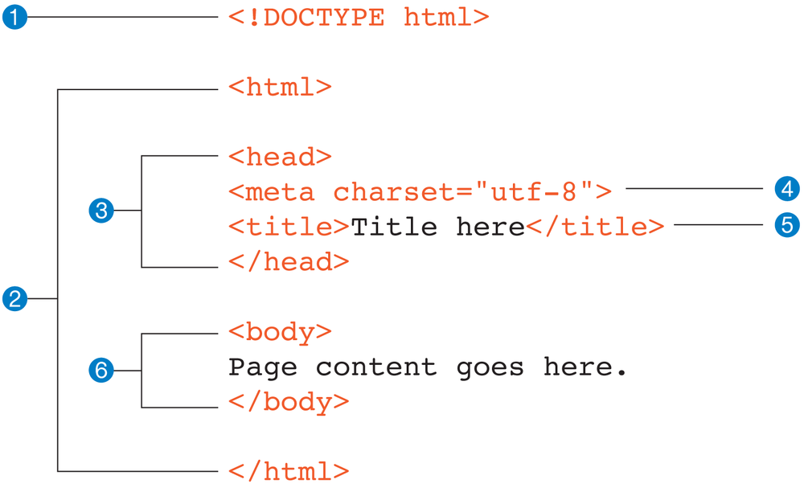
ANATOMY OF HTML DOCUMENT
1
document type declaration
Identifies the document as HTML5
2
Root element
contains all elements in the doc
3
HTML head section
contains important information about the page
4
Meta element
Provides keywords and descriptions
Helps search engine to rank the page
5
HTML Title
to define the title of the web page
mandatory
6
HTML body Section
contains everything to be displayed
2
3
5
6
and are four essential tags that form the basic structure called Document Structure tags.

Slide 13

HTML Document Structure
All HTML documents must start with a document type declaration: <!DOCTYPE html>.
Entire document enclosed within <html> and </html> tags
Two subparts:
  Head
    Enclosed within <head> and </head>
    Within the head, more tags can be used to specify title of the page, meta-information, etc.
  Body
    Enclosed within <body> and </body>
    Within the body, content is to be displayed
    Other tags can be embedded in the body

Slide 14
The <head> Section
Contains information that doesn’t show directly on the viewable page
Starts after the <html> opening tag
Begins with <head> and ends with </head>
Contains mandatory single <title> tag
Can contain some other tags, e.g.
  <meta>
  <script>
  <style>
  <!–- comments -->

Slide 15
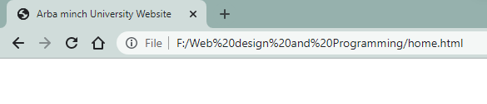
<head> Section: <title> tag
Title should be placed between <head> and </head> tags
Used to specify a title in the window title bar
Search engines and people rely on titles
<title>Arba minch University Website</title>

Slide 16
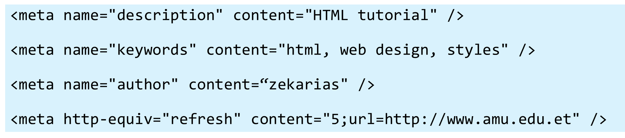
<head> Section: <meta>
Meta tags additionally describe the content contained within the page

Slide 17
<head> Section: <script>
The <script> element is used to embed scripts into an HTML document
  Script are executed in the client's Web browser
  Scripts can live in the <head> and in the <body> sections
Supported client-side scripting languages:
  JavaScript (it is not Java!)
  VBScript
  JScript

Slide 18
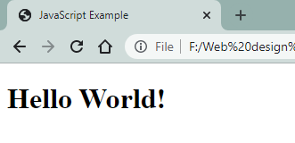
The <script> Tag – Example
<!DOCTYPE HTML>
<html>
<head>
<title>JavaScript Example</title>
<script type="text/javascript">
function sayHello() {
document.write("<p>Hello World!<\/p>");
}
</script>
</head>
<body>
<script type=
"text/javascript">
sayHello();
</script>
</body>
</html>

Slide 19
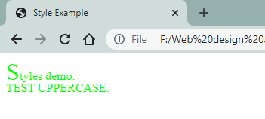
<head> Section: <style>
The <style> element embeds formatting information (CSS styles) into an HTML page
<html>
<head>
<style type="text/css">
p { font-size: 12pt; line-height: 12pt; }
p:first-letter { font-size: 200%; }
span { text-transform: uppercase; }
</style>
</head>
<body>
<p>Styles demo.<br />
<span>Test uppercase</span>.
</p>
</body>
</html>

Slide 20
Comments: <!-- --> Tag
Comments can exist anywhere between the <html></html> tags
Comments start with <!-- and end with -->
<!–- AMU Logo (a JPG file) -->
<img src="logo.jpg" alt=“amu Logo">
<!–- Hyperlink to the web site -->
<a href="http://amu.edu.et.com/">Arba Minch University</a>
<!–- Show the news table -->
<table class="newstable">
...

Slide 21
<body> Section: Introduction
The <body> section describes the viewable portion of the page
Starts after the <head> </head> section
Begins with <body> and ends with </body>
<html>
<head><title>Test page</title></head>
<body>
<!-- This is the Web page body -->
</body>
</html>

Slide 22
Headings and Paragraphs – Example
<!DOCTYPE HTML>
<html>
<head><title>Headings and paragraphs</title></head>
<body>
<h1>Heading 1</h1>
<h2>Sub heading 2</h2>
<h3>Sub heading 3</h3>
<p>This is my first paragraph</p>
<p>This is my second paragraph</p>
<div style="background:skyblue">
This is a div</div>
</body>
</html>
headings.html

Slide 23
Text Formatting
Text formatting tags modify the text between the opening tag and the closing tag
  Ex. <b>Hello</b> makes “Hello” bold
<b></b> | bold
<i></i> | italicized
<u></u> | underlined
<sup></sup> | Sample^{superscript}
<sub></sub> | Sample_{subscript}
<strong></strong> | strong
<em></em> | emphasized
<pre></pre> | Preformatted text
<blockquote></blockquote> | Quoted text block
<del></del> | Deleted text – strike through
23

Slide 24
Text Formatting – Example
<!DOCTYPE html PUBLIC "-//W3C//DTD XHTML 1.0 Transitional//EN"
"http://www.w3.org/TR/xhtml1/DTD/xhtml1-transitional.dtd">
<html>
<head>
<title>Page Title</title>
</head>
<body>
<h1>Notice</h1>
<p>This is a <em>sample</em> Web page.</p>
<p><pre>Next paragraph:
preformatted.</pre></p>
<h2>More Info</h2>
<p>Specifically, we’re using XHMTL 1.0 transitional.<br />
Next line.</p>
</body>
</html>

Slide 25
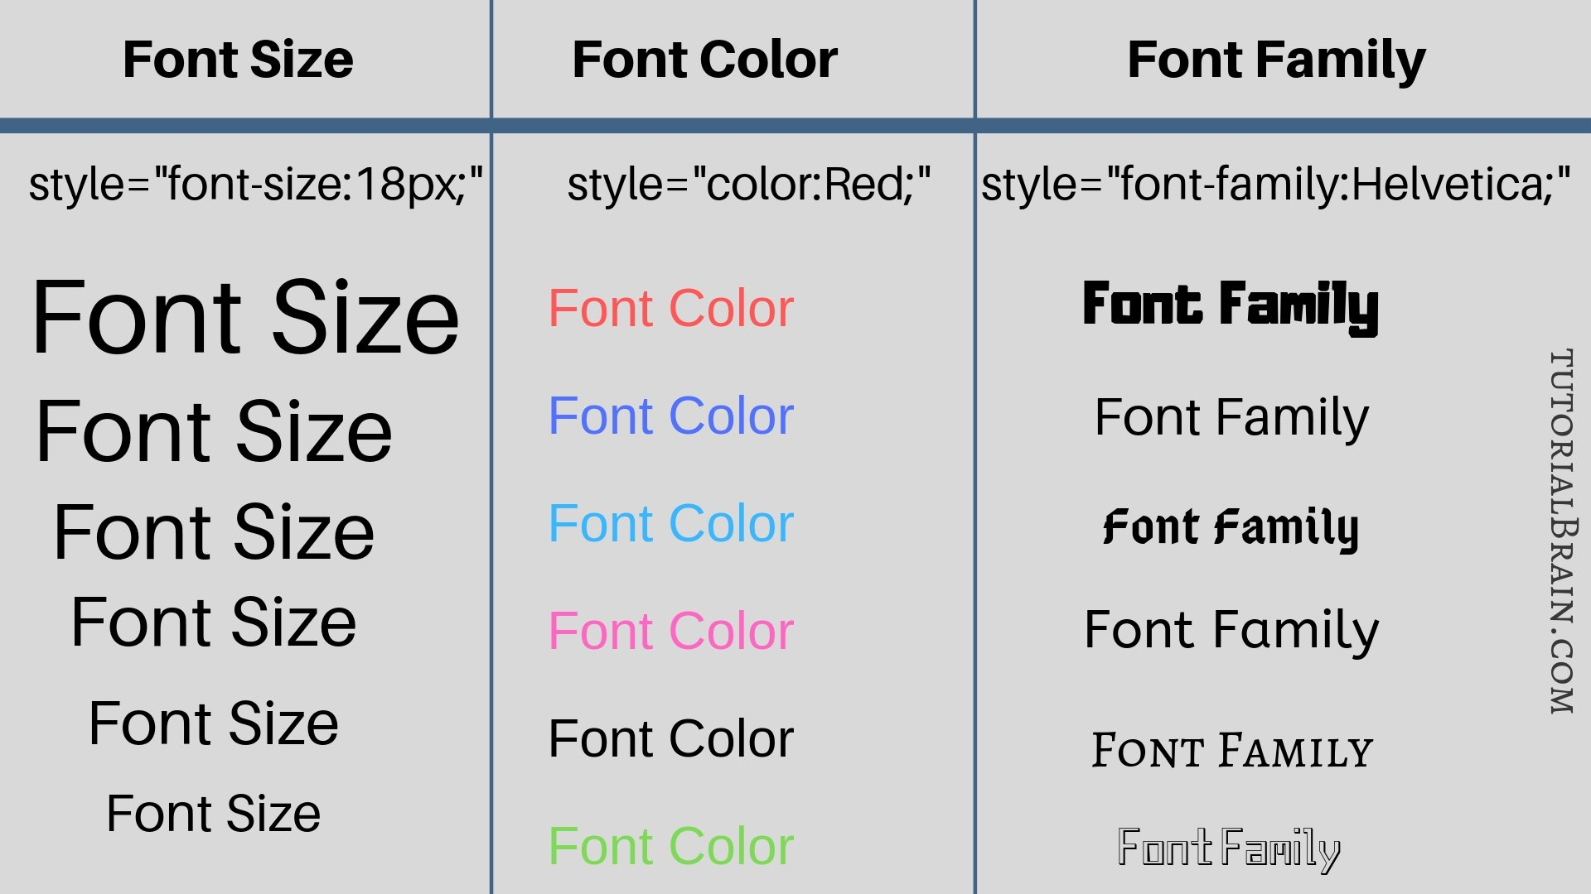
  HTML styles
The HTML style attribute is used to add styles to an element, such as color, font, size, and more.
<h1 style="color:blue;">This is a heading</h1>
<p style="color:red;">This is a paragraph.</p>
Use the style attribute for styling HTML elements
background-color for background color
color for text colors
font-family for text fonts
font-size for text sizes
text-align for text alignment

Slide 26
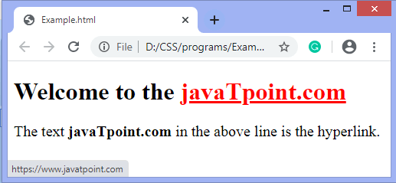
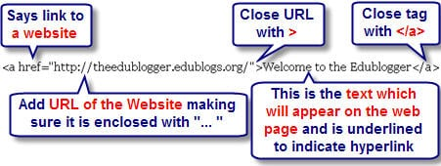
  HTML links - hyperlinks
Links are found in nearly all web pages.
Links allow users to click their way from page to page.
Syntax: <a href="url">link text</a>
The target Attribute
self - Default. Opens the document in the same window/tab as it was clicked
_blank - Opens the document in a new window or tab

Slide 27
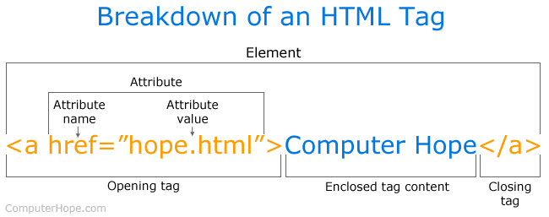
  HTML links
An HTML link is displayed in a different color depending on whether it has been visited, is unvisited, or is active.
HTML Link Colors
By default, a link will appear like this (in all browsers):
An unvisited link is underlined and blue
A visited link is underlined and purple
An active link is underlined and red
HTML Links - Create Bookmarks
HTML links can be used to create bookmarks, so that readers can jump to specific parts of a web page.
Bookmarks can be useful if a web page is very long.
To create a bookmark - first create the bookmark, then add a link to it.
When the link is clicked, the page will scroll down or up to the location with the bookmark.
<h2 id="C4">Chapter 4</h2>
<a href="#C4">Jump to Chapter 4</a>

Slide 28
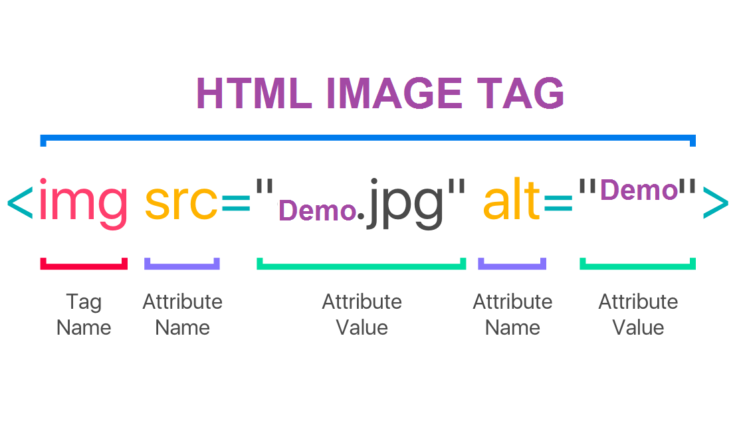
  HTML images
The HTML <img> tag is used to embed an image in a web page.
The <img> tag is empty, it contains attributes only, and does not have a closing tag.
The <img> tag has two required attributes:
src - Specifies the path to the image
alt - Specifies an alternate text for the image
Syntax: <img src="url" alt="alternatetext">
Image Size - Width and Height
<img src=“ronaldo.jpg" alt=“ronaldo image" style="width:500px;height:600px;">

Slide 29
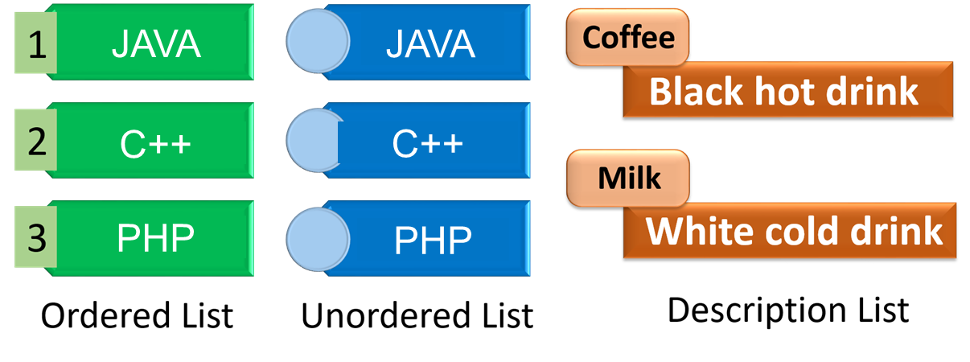
  HTML Lists
HTML lists are used to present list of information in well formed and semantic way.
There are three different types of list in HTML.
  Ordered list —to create a list of related items, in a specific order.
  Unordered list — to create a list of related items, in no particular order.
  Description list —to create a list of terms and their descriptions.

Slide 30
Ordered Lists: <ol> Tag
Create an Ordered List using <ol></ol>:
<ol type="1">
<li>Apple</li>
<li>Orange</li>
<li>Grapefruit</li>
</ol>
type="1"
type="A"
type="a"
type="I"
type="i"
Apple
Orange
Grapefruit
Apple
Orange
Grapefruit
Apple
Orange
Grapefruit
Apple
Orange
Grapefruit
Apple
Orange
Grapefruit

Slide 31
Unordered Lists: <ul> Tag
<ul type="disk">
<li> Apple </li>
<li> Orange </li>
<li> Grapefruit </li>
</ul>
Create an Unordered List using <ul></ul>:
type="disk"
type="circle"
type="square"
Apple
Orange
Grapefruit
Apple
Orange
Grapefruit
Apple
Orange
Grapefruit

Slide 32
Definition lists: <dl> tag
Create definition lists using <dl>
<dl>
<dt>HTML</dt>
<dd>A markup language …</dd>
<dt>CSS</dt>
<dd>Language used to …</dd>
</dl>
  Renders without bullets
  Definition is indented
HTML
  A markup language …
CSS
  Language used to ..

Slide 33
HTML Special Characters
Symbol Name
HTML Entity
Symbol
Copyright Sign
&copy;
©
Registered Trademark Sign
&reg;
®
Trademark Sign
&trade;
™
Less Than
&lt;
<
Greater Than
&gt;
>
Ampersand
&amp;
&
Non-breaking Space
&nbsp;
Em Dash
&mdash;
—
Quotation Mark
&quot;
"
Euro
&#8364;
€
British Pound
&pound;
£
Japanese Yen
&yen;
¥
33

Slide 34
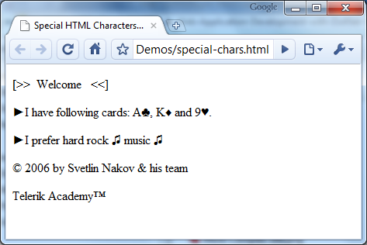
Special Chars – Example
<p>[&gt;&gt;&nbsp;&nbsp;Welcome &nbsp;&nbsp;&lt;&lt;]</p>
<p>&#9658;I have following cards: A&#9827;, K&#9830; and 9&#9829;.</p>
<p>&#9658;I prefer hard rock &#9835; music &#9835;</p>
<p>&copy; 2006 by Svetlin Nakov &amp; his team</p>
<p>Telerik Academy &trade;</p>

Slide 35
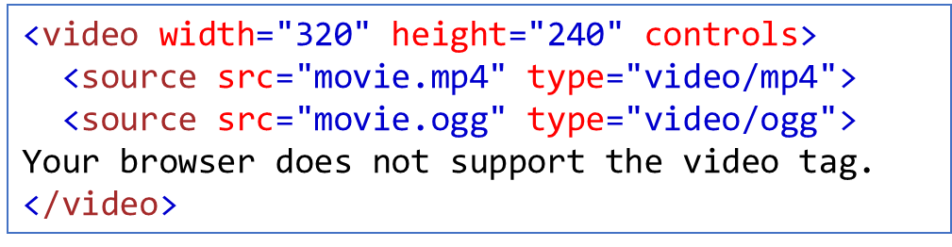
  HTML Multimedia
Multimedia on the web is sound, music, videos, movies, and animations.
HTML Video
The HTML <video> element is used to show a video on a web page.
To start a video automatically, use the autoplay
To start a video automatically, use the autoplay but muted, add attribute: muted
The <track> tag specifies text tracks for <audio> or <video> elements.
Note: Only MP4, WebM, and Ogg video are supported by the HTML standard.
adds video controls, like play, pause, and volume
allows you to specify alternative video files

Slide 36
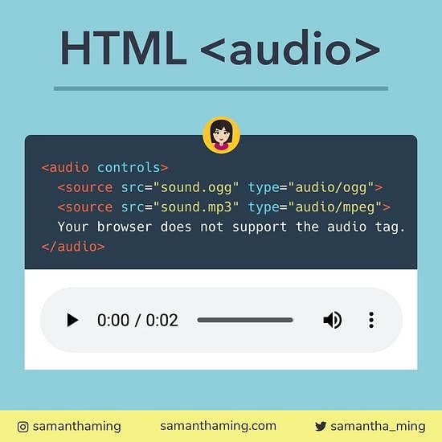
  HTML Multimedia
HTML Audio
The HTML <audio> element is used to play an audio file on a web page.
<audio controls autoplay muted>
Note: Only MP3, WAV, and Ogg audio are supported by the HTML standard.
Add muted after autoplay to let your audio file start playing automatically (but muted):

Slide 37
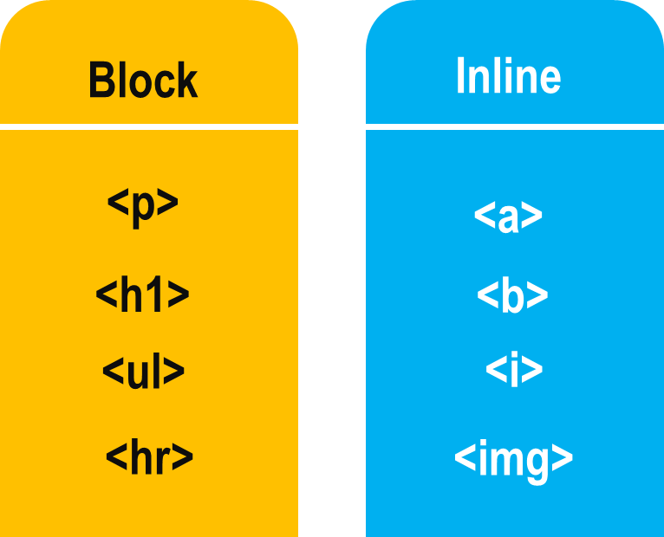
Block and Inline Elements
Block elements add a line break before and after them
  <div> is a block element
  Other block elements are <table>, <hr>, headings, lists, <p> and etc.
Inline elements don’t break the text before and after them
  <span> is an inline element
  Most HTML elements are inline, e.g. <a>

Slide 38
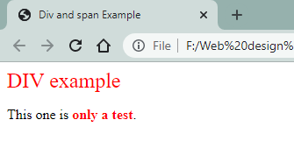
The <div> and <span>Tag
<div> is Block style element
  It creates logical divisions within a page
  Used with CSS
<span> is Inline style element
  Useful for modifying a specific portion of text
  Don't create a separate area in the document
  Very useful with CSS
Example:
<div style="font-size:24px; color:red">DIV example</div>
<p>This one is <span style="color:red; font-weight:bold">only a test</span>.</p>

Slide 39

Working with HTML Tables
Tables represent tabular data
  A table consists of one or several rows
  Each row has one or more columns
Tables comprised of several core tags:
  <table></table>: begin / end the table
  <tr></tr>: create a table row
  <td></td>: create tabular data (cell)
Tables should not be used for layout. Use CSS floats and positioning styles instead

Slide 40
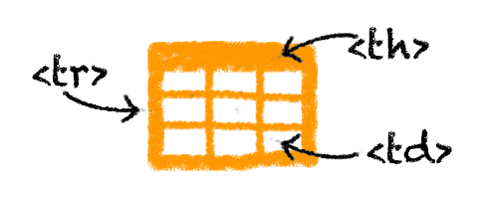
… cont’d
Start and end of a table
Start and end of a row
Start and end of a cell in a row
<table> ... </table>
<tr> ... </tr>
<td> ... </td>

Slide 41
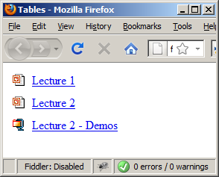
Simple HTML Tables – Example
<table cellspacing="0" cellpadding="5">
<tr>
<td><img src="ppt.gif"></td>
<td><a href="lecture1.ppt">Lecture 1</a></td>
</tr>
<tr>
<td><img src="ppt.gif"></td>
<td><a href="lecture2.ppt">Lecture 2</a></td>
</tr>
<tr>
<td><img src="zip.gif"></td>
<td><a href="lecture2-demos.zip">
Lecture 2 - Demos</a></td>
</tr>
</table>

Slide 42
Complete HTML Tables
Table rows split into three semantic sections: header, body and footer
  <thead> denotes table header and contains <th> elements, instead of <td> elements
  <tbody> denotes collection of table rows that contain the very data
  <tfoot> denotes table footer but comes BEFORE the <tbody> tag
  <colgroup> and <col> define columns (most often used to set column widths)

Slide 43
Complete HTML Table: Example
<table>
<colgroup>
<col style="width:100px" /><col />
</colgroup>
<thead>
<tr><th>Column 1</th><th>Column 2</th></tr>
</thead>
<tfoot>
<tr><td>Footer 1</td><td>Footer 2</td></tr>
</tfoot>
<tbody>
<tr><td>Cell 1.1</td><td>Cell 1.2</td></tr>
<tr><td>Cell 2.1</td><td>Cell 2.2</td></tr>
</tbody>
</table>
columns
header
th
footer
Last comes the body (data)

Slide 44
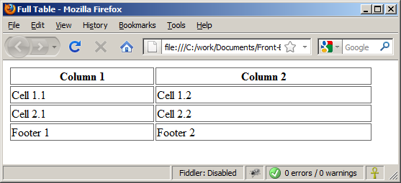
Complete HTML Table:Example (2)
<table>
<colgroup>
<col style="width:200px" /><col />
</colgroup>
<thead>
<tr><th>Column 1</th><th>Column 2</th></tr>
</thead>
<tfoot>
<tr><td>Footer 1</td><td>Footer 2</td></tr>
</tfoot>
<tbody>
<tr><td>Cell 1.1</td><td>Cell 1.2</td></tr>
<tr><td>Cell 2.1</td><td>Cell 2.2</td></tr>
</tbody>
</table>
By default, header text is bold and centered.
Although the footer is before the data in the code, it is displayed last

Slide 45
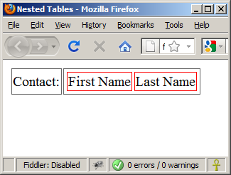
Nested Tables
Table data “cells” (<td>) can contain nested tables (tables within tables):
<table>
<tr>
<td>Contact:</td>
<td>
<table>
<tr>
<td>First Name</td>
<td>Last Name</td>
</tr>
</table>
</td>
</tr>
</table>

Slide 46
Cell Spacing and Padding
Tables have two important attributes:
cellspacing
Defines the empty space between cells
cellpadding
Defines the empty space around the cell content
cell
cell
cell
cell
cell
cell
cell
cell

Slide 47
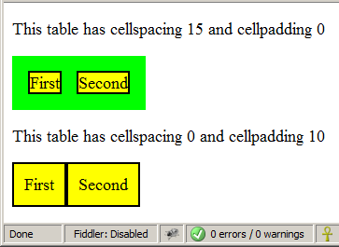
Cell Spacing and Padding – Example
<html>
<head><title>Table Cells</title></head>
<body>
<table cellspacing="15" cellpadding="0">
<tr><td>First</td>
<td>Second</td></tr>
</table>
<br/>
<table cellspacing="0" cellpadding="10">
<tr><td>First</td><td>Second</td></tr>
</table>
</body>
</html>

Slide 48
Column and Row Span
Table cells have two important attributes:
colspan
Defines how many columns the cell occupies
rowspan
Defines how many rows the cell occupies
colspan="1"
colspan="1"
rowspan="2"
rowspan="1"
cell[1,1]
cell[1,2]
cell[1,1]
cell[1,2]
cell[2,1]
cell[2,1]
colspan="2"
rowspan="1"

Slide 49
Column and Row Span – Example
<table cellspacing="0">
<tr class="1"><td>Cell[1,1]</td>
<td colspan="2">Cell[2,1]</td></tr>
<tr class=“2"><td>Cell[1,2]</td>
<td rowspan="2">Cell[2,2]</td>
<td>Cell[3,2]</td></tr>
<tr class=“3"><td>Cell[1,3]</td>
<td>Cell[2,3]</td></tr>
</table>

Slide 50
Column and Row Span – Example (2)
<table cellspacing="0">
<tr class="1"><td>Cell[1,1]</td>
<td colspan="2">Cell[2,1]</td></tr>
<tr class=“2"><td>Cell[1,2]</td>
<td rowspan="2">Cell[2,2]</td>
<td>Cell[3,2]</td></tr>
<tr class=“3"><td>Cell[1,3]</td>
<td>Cell[2,3]</td></tr>
</table>
Cell[1,1]
Cell[2,1]
Cell[1,2]
Cell[2,2]
Cell[3,2]
Cell[1,3]
Cell[2,3]

Slide 51
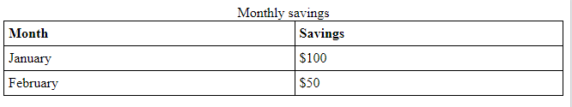
Table caption
<!DOCTYPE html>
<html>
<head>
<style>
table, th, td {
border: 1px solid black;
border-collapse: collapse;
}
th, td {
padding: 5px;
text-align: left;
}
</style>
</head>
<body>
<table style="width:100%">
<caption>Monthly savings</caption>
<tr>
<th>Month</th>
<th>Savings</th>
</tr>
<tr>
<td>January</td>
<td>$100</td>
</tr>
<tr>
<td>February</td>
<td>$50</td>
</tr>
</table>
</body>
</html>

Slide 52
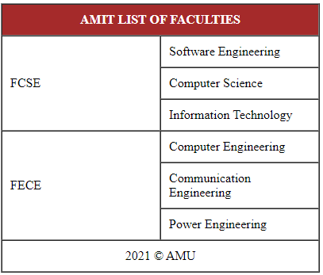
Exercise:

Slide 53
HTML Forms
Forms are the primary method for gathering data from site visitors
Create a form block with
Example:
<form></form>
The “method" attribute tells how the form data should be sent – via GET or POST request
<form name="myForm" method="post" action="path/to/some-script.php">
...
</form>
The "action" attribute tells where the form data should be sent

Slide 54
Form Fields
Single-line text input fields:
Multi-line textarea fields:
Hidden fields contain data not shown to the user:
  Often used by JavaScript code
<input type="text" name="FirstName" value="This is a text field" />
<textarea name="Comments">This is a multi-line text field</textarea>
<input type="hidden" name="Account" value="This is a hidden textfield" />

Slide 55
Fieldsets
Fieldsets are used to enclose a group of related form fields:
The <legend> is the fieldset's title.
<form method="post" action="form.aspx">
<fieldset>
<legend>Client Details</legend>
<input type="text" id="Name" />
<input type="text" id="Phone" />
</fieldset>
<fieldset>
<legend>Order Details</legend>
<input type="text" id="Quantity" />
<textarea cols="40" rows="10"
id="Remarks"></textarea>
</fieldset>
</form>

Slide 56
Form Input Controls
Checkboxes:
Radio buttons:
Radio buttons can be grouped, allowing only one to be selected from a group:
<input type="checkbox" name="fruit" value="apple”/>
<input type="radio" name="title" value="Mr." />
<input type="radio" name="city" value="Lom" />
<input type="radio" name="city" value="Ruse" />

Slide 57
Other Form Controls
Dropdown menus:
Submit button:
<select name="gender">
<option value="Value 1"
selected="selected">Male</option>
<option value="Value 2">Female</option>
<option value="Value 3">Other</option>
</select>
<input type="submit" name="submitBtn" value="Apply Now" />

Slide 58
Other Form Controls (2)
Reset button – brings the form to its initial state
Image button – acts like submit but image is displayed and click coordinates are sent
Ordinary button – used for JavaScript, no default action
<input type="reset" name="resetBtn" value="Reset the form" />
<input type="image" src="submit.gif" name="submitBtn" alt="Submit" />
<input type="button" value="click me" />

Slide 59
Other Form Controls (3)
Password input – a text field which masks the entered text with * signs
Multiple select field – displays the list of items in multiple lines, instead of one.
<input type="password" name="pass" />
<select name="products" multiple="multiple">
<option value="Value 1"
selected="selected">keyboard</option>
<option value="Value 2">mouse</option>
<option value="Value 3">speakers</option>
</select>

Slide 60
Other Form Controls (4)
File input – a field used for uploading files
  When used, it requires the form element to have a specific attribute:
<input type="file" name="photo" />
<form enctype="multipart/form-data">
...
<input type="file" name="photo" />
...
</form>

Slide 61
Labels
Form labels are used to associate an explanatory text to a form field using the field's ID.
Clicking on a label focuses its associated field (checkboxes are toggled, radio buttons are checked)
Labels are both a usability and accessibility feature and are required in order to pass accessibility validation.
<label for="fn">First Name</label>
<input type="text" id="fn" />

Slide 62
HTML Forms – Example
<form method="post" action="apply-now.php">
<input name="subject" type="hidden" value="Class" />
<fieldset><legend>Academic information</legend>
<label for="degree">Degree</label>
<select name="degree" id="degree">
<option value="BA">Bachelor of Art</option>
<option value="BS">Bachelor of Science</option>
<option value="MBA" selected="selected">Master of
Business Administration</option>
</select>
<br />
<label for="studentid">Student ID</label>
<input type="password" name="studentid" />
</fieldset>
<fieldset><legend>Personal Details</legend>
<label for="fname">First Name</label>
<input type="text" name="fname" id="fname" />
<br />
<label for="lname">Last Name</label>
<input type="text" name="lname" id="lname" />

Slide 63
HTML Forms – Example (2)
<br />
Gender:
<input name="gender" type="radio" id="gm" value="m" />
<label for="gm">Male</label>
<input name="gender" type="radio" id="gf" value="f" />
<label for="gf">Female</label>
<br />
<label for="email">Email</label>
<input type="text" name="email" id="email" />
</fieldset>
<p>
<textarea name="terms" cols="30" rows="4"
readonly="readonly">TERMS AND CONDITIONS...</textarea>
</p>
<p>
<input type="submit" name="submit" value="Send Form" />
<input type="reset" value="Clear Form" />
</p>
</form>

Slide 64
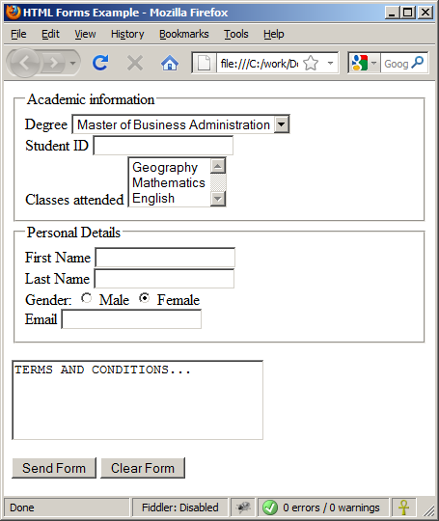
HTML Forms – Example (3)

Slide 65
TabIndex
The tabindex HTML attribute controls the order in which form fields and hyperlinks are focused when repeatedly pressing the TAB key
  tabindex="0" (zero) - "natural" order
  If X < Y, then elements with tabindex="X" are iterated before elements with tabindex="Y"
  Elements with negative tabindex are skipped, however, this is not defined in the standard
  Is in the range [0,32767]
<input type="text" tabindex="10" />

Slide 66
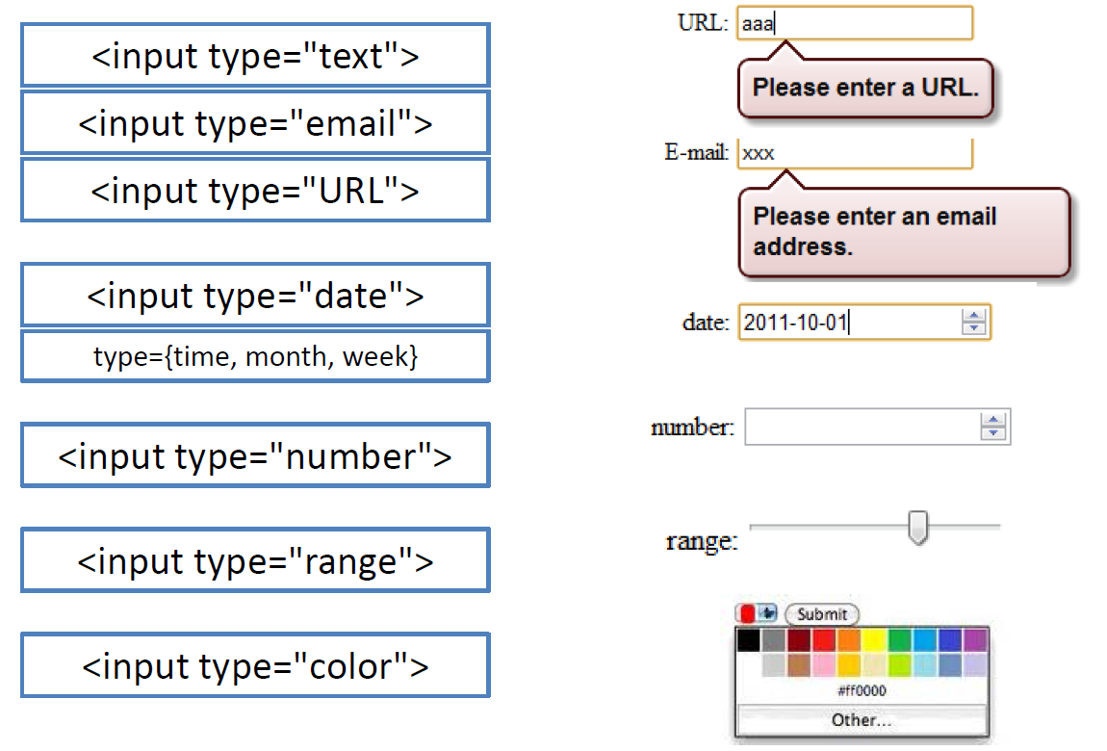
HTML5: New form elements

Slide 67
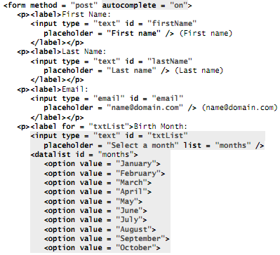

Input-datalist Elements and autocomplete Attribute

Slide 68
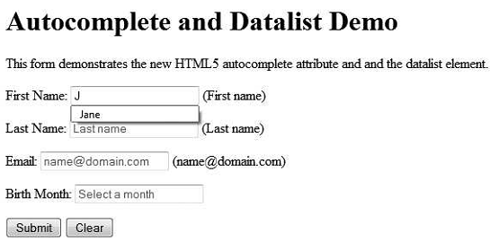
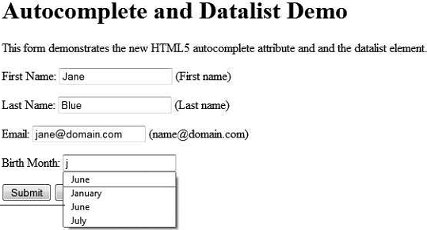
Output
Once you fill a data in the text box ..html 5 can recover the previous input.
*we use a datalist element to
obtain the user’s birth month.

Slide 69
HTML Frames
Frames provide a way to show multiple HTML documents in a single Web page
The page can be split into separate views (frames) horizontally and vertically
Frames were popular in the early ages of HTML development, but now their usage is rejected
Frames are not supported by all user agents (browsers, search engines, etc.)
  A <noframes> element is used to provide content for non-compatible agents.

Slide 70
HTML Frames – Demo
frames.html
<html>
<head><title>Frames Example</title></head>
<frameset cols="180px,*,150px">
<frame src="left.html" />
<frame src="middle.html" />
<frame src="right.html" />
</frameset>
</html>

Slide 71
Inline Frames: <iframe>
Inline frames provide a way to show one website inside another website:
iframe-demo.html
<iframe name="iframeGoogle" width="600" height="400" src="http://www.google.com" frameborder="yes" scrolling="yes"></iframe>

Slide 72
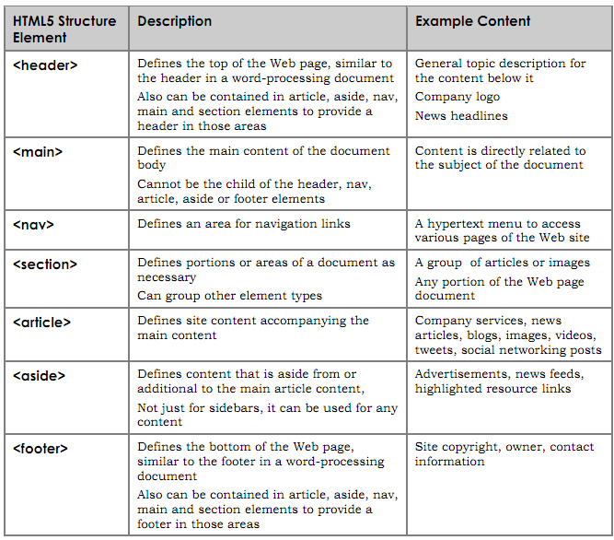
Table:html structure elements

Slide 73
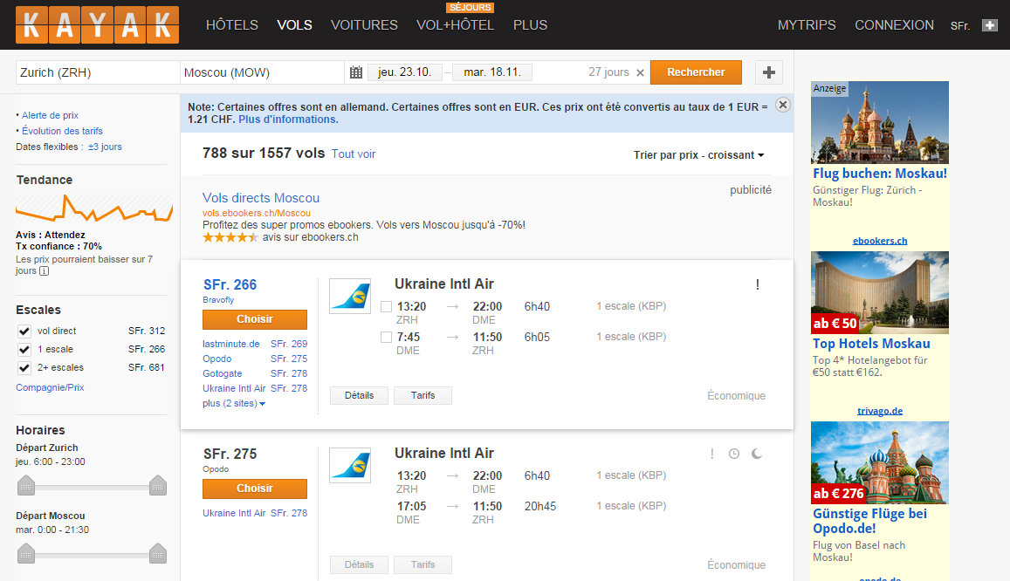
HTML5: Semantic elements example
<header>
<nav>
<aside>
<section>
<footer>
Notes:
section – Used for grouping together thematically-related content. Sounds like a div element, but its not. The div has no semantic meaning. Before replacing all your div’s with section elements, always ask yourself, “Is all of the content related?”
aside – Used for tangentially related content. Just because some content appears to the left or right of the main content isn’t enough reason to use the aside element. Ask yourself if the content within the aside can be removed without reducing the meaning of the main content. Pull quotes are an example of tangentially related content.
header – There is a crucial difference between the header element and the general accepted usage of header (or masthead). There’s usually only one header or ‘masthead’ in a page. In HTML5 you can have as many as you want. The spec defines it as “a group of introductory or navigational aids”. You can use a header in any section on your site. In fact, you probably should use a header within most of your sections. The spec describes the section element as “a thematic grouping of content, typically with a heading.”
nav – Intended for major navigation information. A group of links grouped together isn’t enough reason to use the nav element. Site-wide navigation, on the other hand belongs in a nav element.
footer – Sounds like its a description of the position, but its not. Footer elements contain information about it’s containing element: who wrote it, copyright, links to related content, etc. Whereas we usually have one footer for an entire document, HTML5 allows us to also have footer within sections.

Slide 74
The End!D

